Slide 1

CHAPTER 6
SET THEORY
Copyright © Cengage Learning. All rights reserved.

Slide 2
SECTION 6.2
Properties of Sets
Copyright © Cengage Learning. All rights reserved.

Slide 3
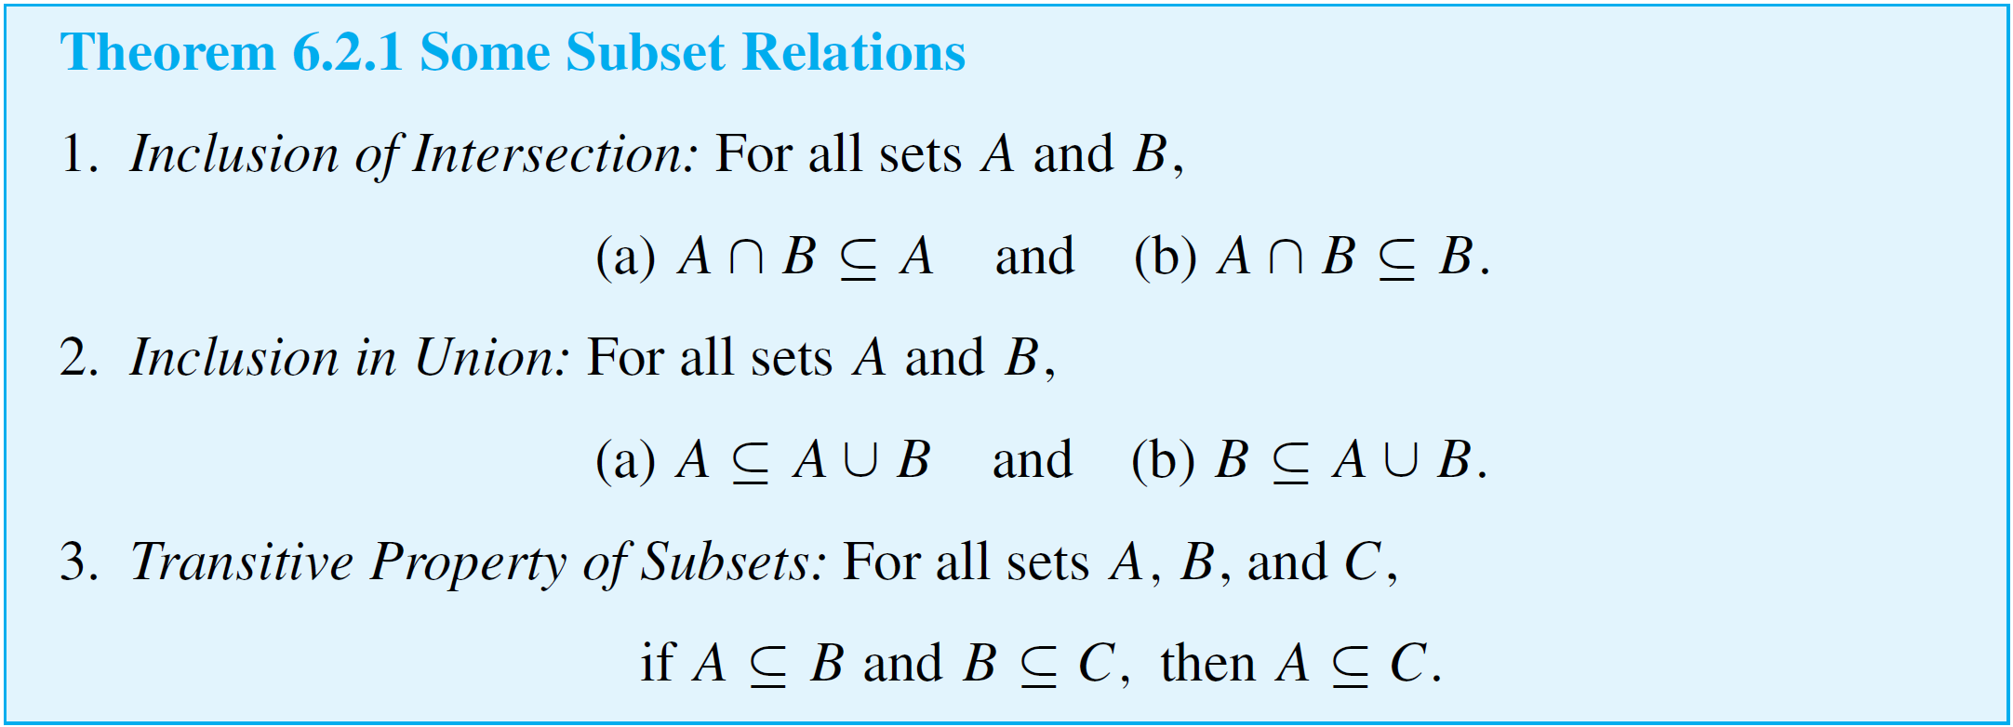
Properties of Sets
We begin by listing some set properties that involve subset relations.

Slide 4
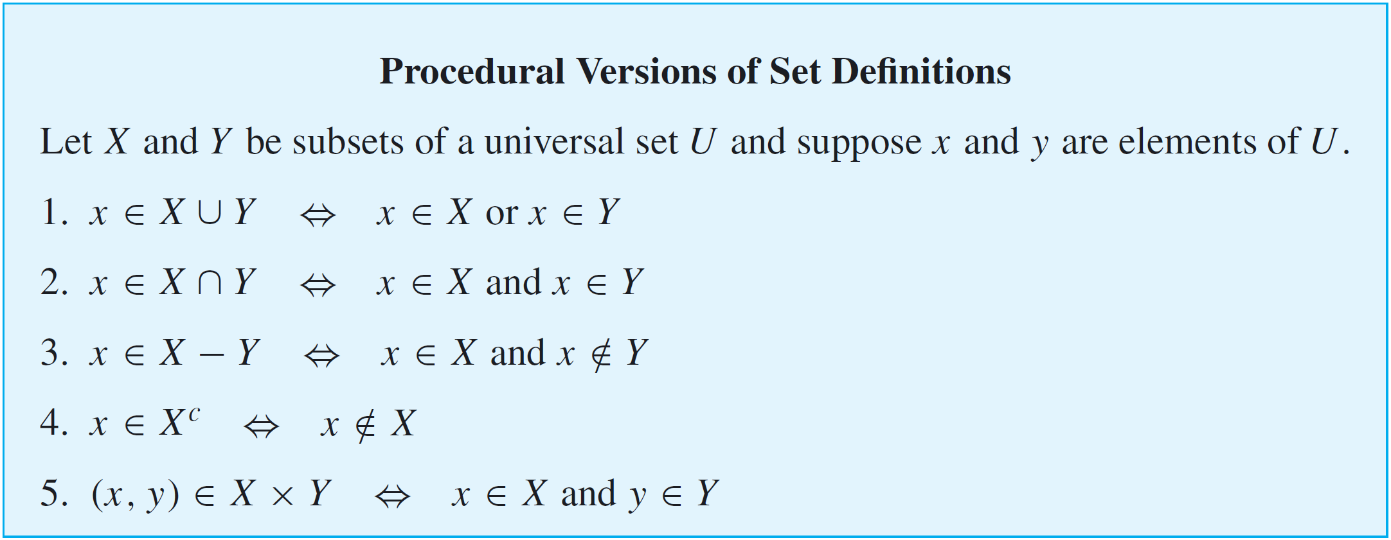
Properties of Sets
Procedural versions of the definitions of the other set operations are derived similarly and are summarized below.

Slide 5
Example 1 – Proof of a Subset Relation
Prove Theorem 6.2.1(1)(a): For all sets A and B,
A ∩ B ⊆ A.
Solution:
We start by giving a proof of the statement and then explain how you can obtain such a proof yourself.

Slide 6
Example 1 – Solution
cont’d
Proof:
Suppose A and B are any sets and suppose x is any element of A ∩ B.
Then x ∈ A and x ∈ B by definition of intersection.
In particular, x ∈ A .
Thus A ∩ B ⊆ A.

Slide 7
Example 1 – Solution
cont’d
The underlying structure of this proof is not difficult, but it is more complicated than the brevity of the proof suggests.
The first important thing to realize is that the statement to be proved is universal (it says that for all sets A and B,
A ∩ B ⊆ A).
The proof, therefore, has the following outline:
Starting Point: Suppose A and B are any (particular but arbitrarily chosen) sets.
To Show: A ∩ B ⊆ A

Slide 8
Example 1 – Solution
cont’d
Now to prove that A ∩ B ⊆ A, you must show that
∀x, if x ∈ A ∩ B then x ∈ A.
But this statement also is universal. So to prove it, you
suppose x is an element in A ∩ B
and then you
show that x is in A.

Slide 9
Example 1 – Solution
cont’d
Filling in the gap between the “suppose” and the “show” is easy if you use the procedural version of the definition of intersection: To say that x is in A ∩ B means that
x is in A and x is in B.
This allows you to complete the proof by deducing that, in particular,
x is in A,
as was to be shown.
Note that this deduction is just a special case of the valid argument form
p ∧ q
• p.

Slide 10
Set Identities

Slide 11
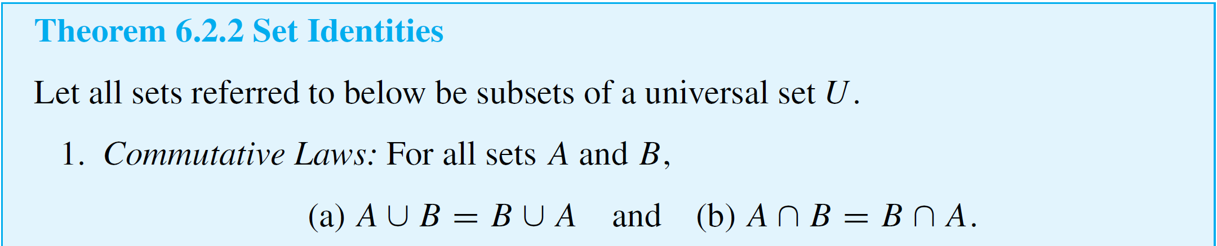
Set Identities
An identity is an equation that is universally true for all elements in some set. For example, the equation
a + b = b + a is an identity for real numbers because it is true for all real numbers a and b.
The collection of set properties in the next theorem consists entirely of set identities. That is, they are equations that are true for all sets in some universal set.

Slide 12
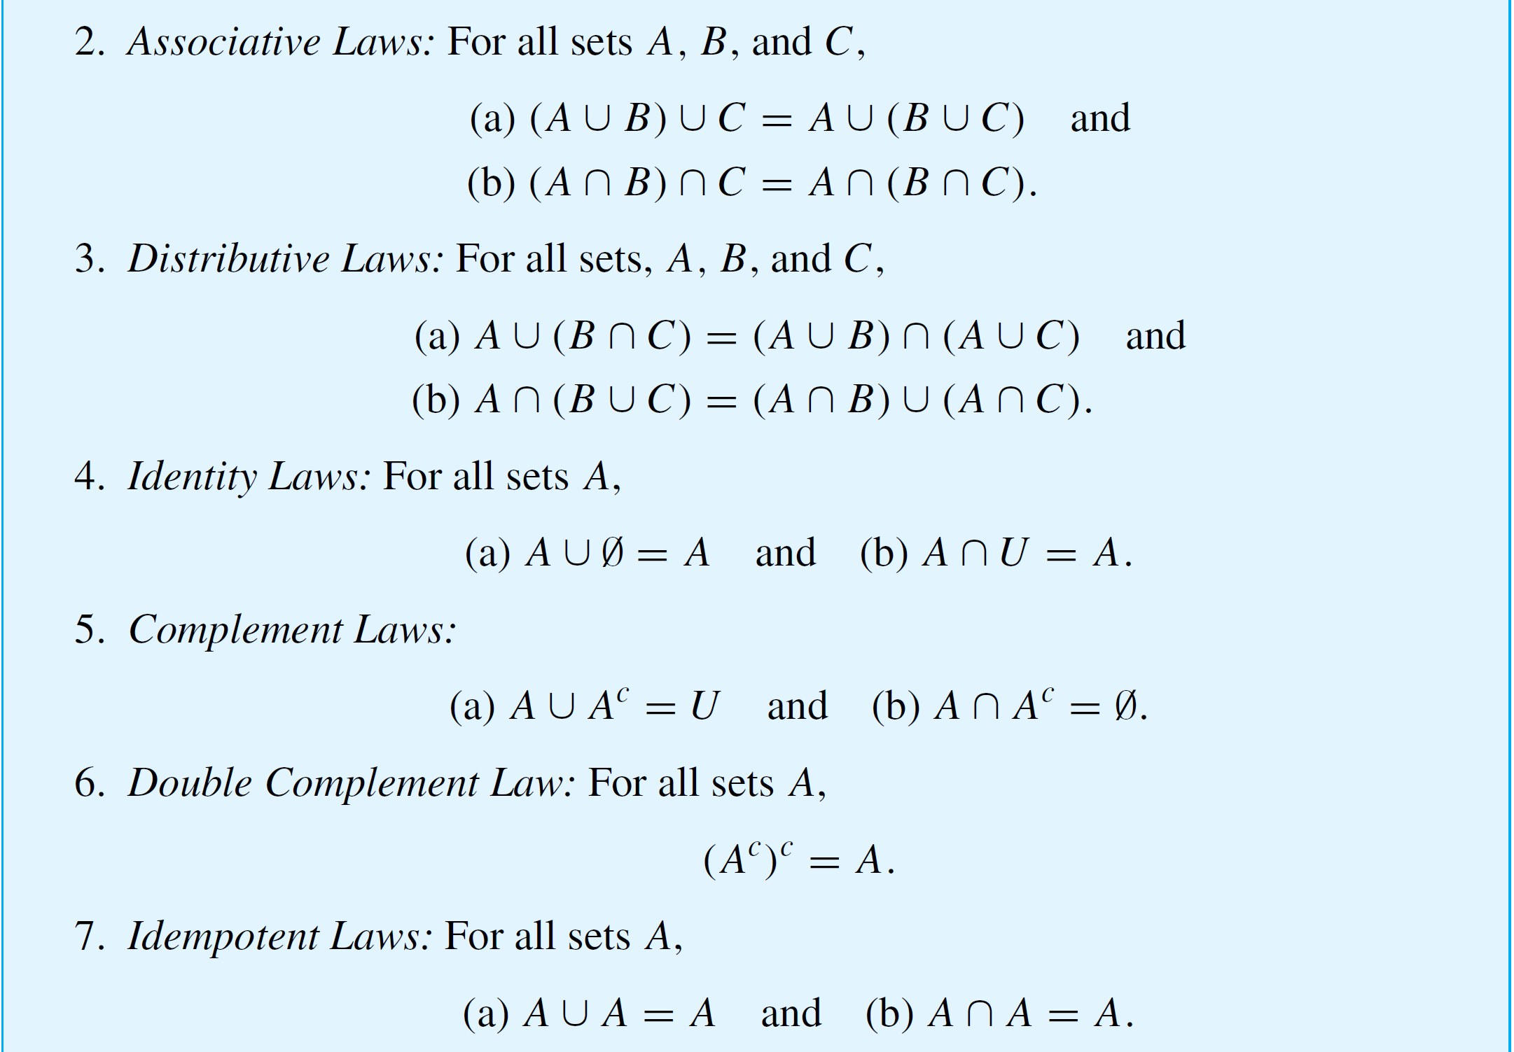
Set Identities
cont’d

Slide 13
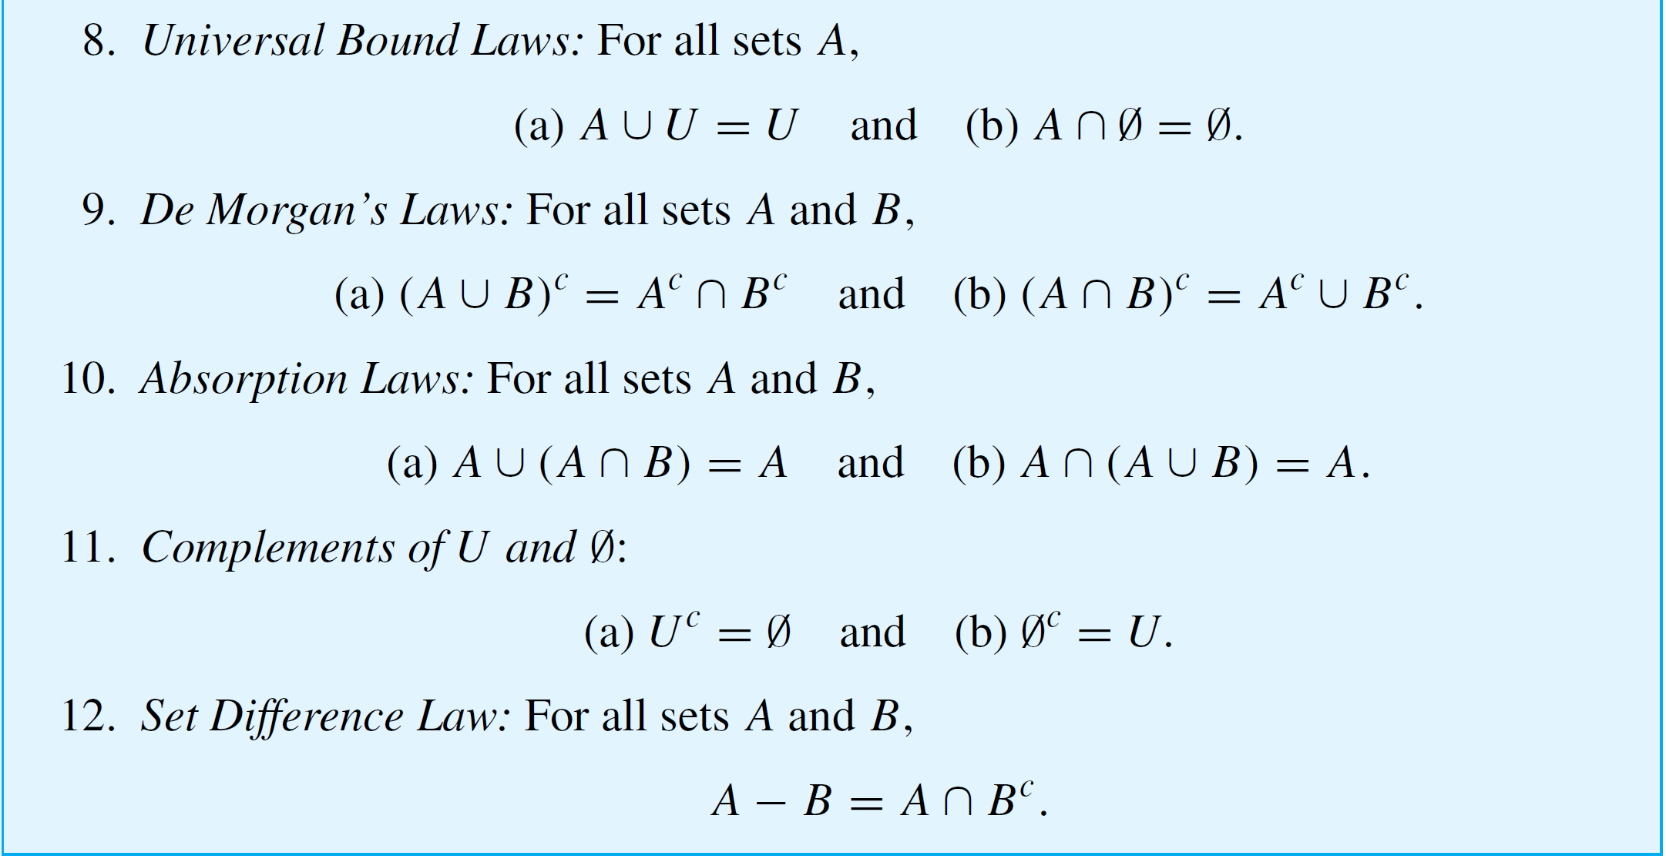
Set Identities
cont’d

Slide 14
Proving Set Identities

Slide 15
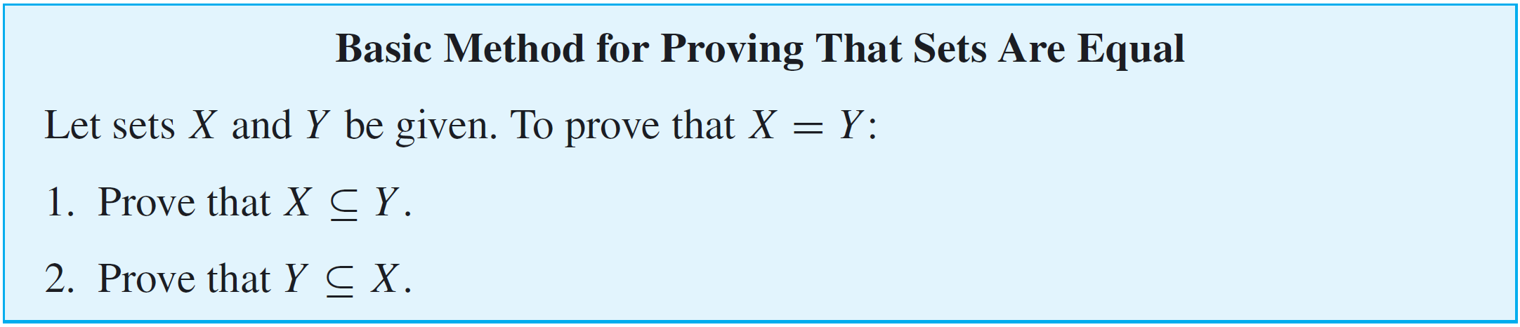
Proving Set Identities
As we have known,
Two sets are equal ⇔ each is a subset of the other.
The method derived from this fact is the most basic way to prove equality of sets.

Slide 16
Example 2 – Proof of a Distributive Law
Prove that for all sets A, B, and C,
A ∪ (B ∩ C) = (A ∪ B) ∩ (A ∪ C).
Solution:
The proof of this fact is somewhat more complicated than the proof in Example 1, so we first derive its logical structure, then find the core arguments, and end with a formal proof as a summary.

Slide 17
Example 2 – Solution
cont’d
As in Example 1, the statement to be proved is universal, and so, by the method of generalizing from the generic particular, the proof has the following outline:
Starting Point: Suppose A, B, and C are arbitrarily chosen sets.
To Show: A ∪ (B ∩ C) = (A ∪ B) ∩ (A ∪ C).

Slide 18
Example 2 – Solution
cont’d
Now two sets are equal if, and only if, each is a subset of the other.
Hence, the following two statements must be proved:
A ∪ (B ∩ C) ⊆ (A ∪ B) ∩ (A ∪ C)
and (A ∪ B) ∩ (A ∪ C) ⊆ A ∪ (B ∩ C).
Showing the first containment requires showing that
∀x, if x ∈ A ∪ (B ∩ C) then x ∈ (A ∪ B) ∩ (A ∪ C).

Slide 19
Example 2 – Solution
cont’d
Showing the second containment requires showing that
∀x, if x ∈ (A ∪ B) ∩ (A ∪ C) then x ∈ A ∪ (B ∩ C).
Note that both of these statements are universal. So to prove the first containment, you
suppose you have any element x in A ∪ (B ∩ C),
and then you
show that x ∈ (A ∪ B) ∩ (A ∪ C).

Slide 20
Example 2 – Solution
cont’d
And to prove the second containment, you
suppose you have any element x in (A ∪ B) ∩ (A ∪ C),
and then you
show that x ∈ A ∪ (B ∩ C).

Slide 21
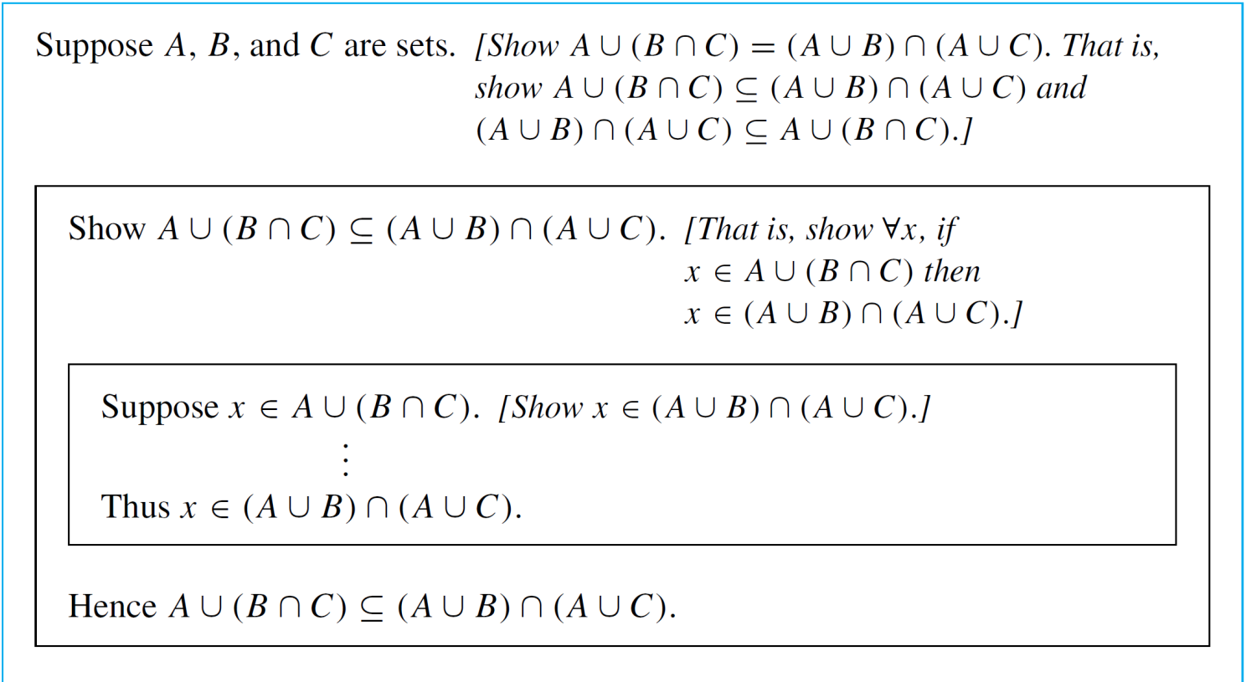
Example 2 – Solution
cont’d
In Figure 6.2.1, the structure of the proof is illustrated by the kind of diagram that is often used in connection with structured programs.
Figure 6.2.1

Slide 22
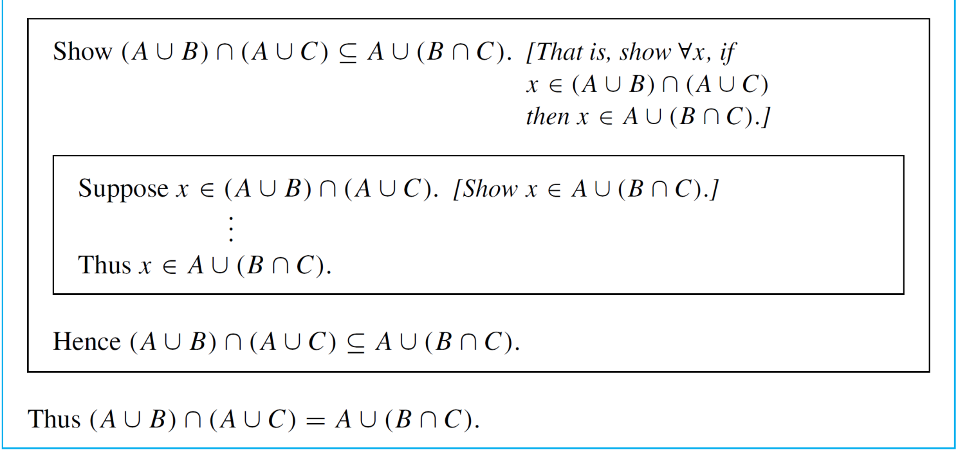
Example 2 – Solution
cont’d
The analysis in the diagram reduces the proof to two concrete tasks: filling in the steps indicated by dots in the two center boxes of Figure 6.2.1.
Figure 6.2.1 (continued)

Slide 23
Example 2 – Solution
cont’d
Filling in the missing steps in the top box:
To fill in these steps, you go from the supposition that
x ∈ A ∪ (B ∩ C) to the conclusion that
x ∈ (A ∪ B) ∩ (A ∪ C).
Now when x ∈ A ∪ (B ∩ C), then by definition of union,
x ∈ A or x ∈ B ∩ C. But either of these possibilities might be the case because x is assumed to be chosen arbitrarily from the set A ∪ (B ∩ C).
So you have to show you can reach the conclusion that
x ∈ (A ∪ B) ∩ (A ∪ C) regardless of whether x happens to be in A or x happens to be in B ∩ C.

Slide 24
Example 2 – Solution
cont’d
This leads you to break your analysis into two cases: x ∈ A and x ∈ B ∩ C.
In case x ∈ A, your goal is to show that
x ∈ (A ∪ B) ∩ (A ∪ C), which means that
x ∈ A ∪ B and x ∈ A ∪ C (by definition of intersection). But when x ∈ A, both statements x ∈ A ∪ B and x ∈ A ∪ C are true by virtue of x’s being in A.
Similarly, in case x ∈ B ∩ C, your goal is also to show that
x ∈ (A ∪ B) ∩ (A ∪ C), which means that x ∈ A ∪ B and
x ∈ A ∪ C.

Slide 25
Example 2 – Solution
cont’d
But when x ∈ B ∩ C, then x ∈ B and x ∈ C (by definition of intersection), and so x ∈ A ∪ B (by virtue of being in B) and x ∈ A ∪ C (by virtue of being in C).
This analysis shows that regardless of whether x ∈ A or
x ∈ B ∩ C, the conclusion x ∈ (A ∪ B) ∩ (A ∪ C) follows. So you can fill in the steps in the top inner box.
Filling in the missing steps in the bottom box:
To fill in these steps, you need to go from the supposition that x ∈ (A ∪ B) ∩ (A ∪ C) to the conclusion that
x ∈ A ∪ (B ∩ C).

Slide 26
Example 2 – Solution
cont’d
When x ∈ (A ∪ B) ∩ (A ∪ C) it is natural to consider the two cases x ∈ A and x ∉ A because when x happens to be in A, then the statement “x ∈ A or x ∈ B ∩ C” is certainly true, and so x is in A ∪ (B ∩ C) by definition of union.
Thus it remains only to show that even in the case when x is not in A, and x ∈ (A ∪ B) ∩ (A ∪ C), then
x ∈ A ∪ (B ∩ C).
So suppose x is not in A. Now to say that
x ∈ (A ∪ B) ∩ (A ∪ C) means that x ∈ A ∪ B and
x ∈ A ∪ C (by definition of intersection). But when
x ∈ A ∪ B, then x is in at least one of A or B, so since x is not in A, then x must be in B.

Slide 27
Example 2 – Solution
cont’d
Similarly, when x ∈ A ∪ C, then x is in at least one of A or C, so since x is not in A, then x must be in C. Thus, when x is not in A and x ∈ (A ∪ B) ∩ (A ∪ C), then x is in both B and C, which means that x ∈ B ∩ C.
It follows that the statement “x ∈ A or x ∈ B ∩ C” is true, and so x ∈ A ∪ (B ∩ C) by definition of union.
This analysis shows that if x ∈ (A ∪ B) ∩ (A ∪ C), then regardless of whether x ∈ A or x ∉ A, you can conclude that x ∈ A ∪ (B ∩ C). Hence you can fill in the steps of the bottom inner box.

Slide 28
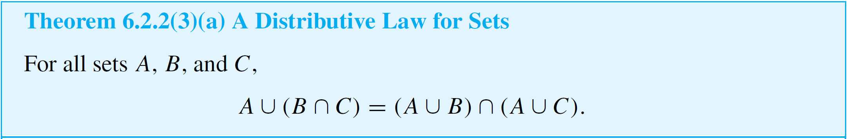
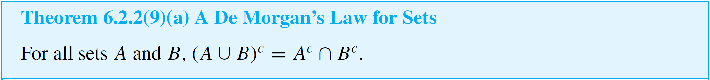
Proving Set Identities
Suppose A and B are arbitrarily chosen sets.

Slide 29
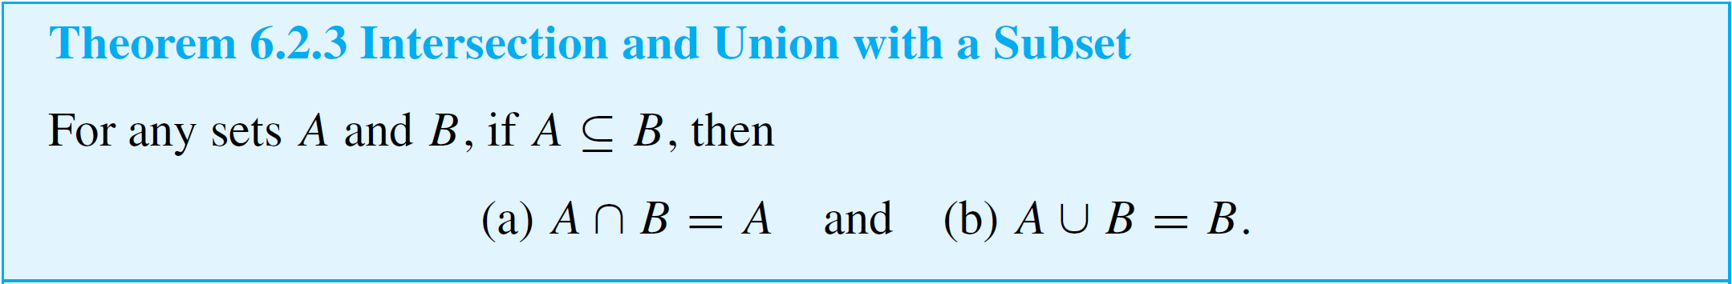
Proving Set Identities
The set property given in the next theorem says that if one set is a subset of another, then their intersection is the smaller of the two sets and their union is the larger of the two sets.

Slide 30
The Empty Set

Slide 31
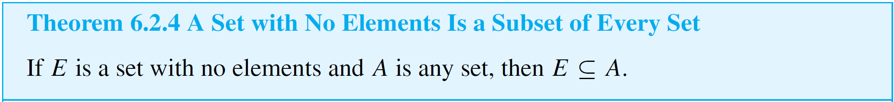
The Empty Set
The crucial fact is that the negation of a universal statement is existential: If a set B is not a subset of a set A, then there exists an element in B that is not in A. But if B has no elements, then no such element can exist.
If E is a set with no elements and A is any set, then to say that E ⊆ A is the same as saying that
∀x, if x ∈ E, then x ∈ A.

Slide 32
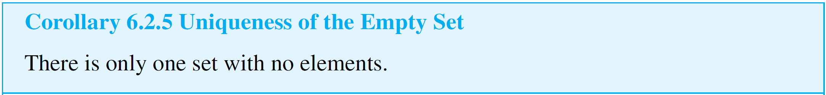
The Empty Set
But since E has no elements, this conditional statement is vacuously true.
How many sets with no elements are there? Only one.
Suppose you need to show that a certain set equals the empty set. By Corollary 6.2.5 it suffices to show that the set has no elements.

Slide 33
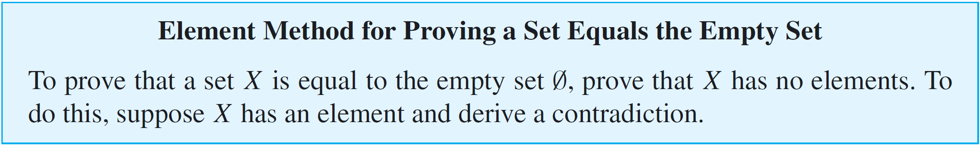
The Empty Set
For since there is only one set with no elements (namely Ø), if the given set has no elements, then it must equal Ø.

Slide 34
Example 5 – A Proof for a Conditional Statement
Prove that for all sets A, B, and C, if A ⊆ B and B ⊆ C^{c}, then A ∩ C = Ø.
Solution:
Since the statement to be proved is both universal and conditional, you start with the method of direct proof:
Suppose A, B, and C are arbitrarily chosen sets
that satisfy the condition: A ⊆ B and B ⊆ C^{c}.
Show that A ∩ C = Ø.

Slide 35
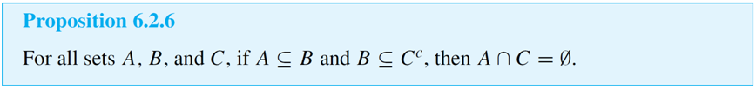
Example 5 – Solution
cont’d
Since the conclusion to be shown is that a certain set is empty, you can use the principle for proving that a set equals the empty set.
A complete proof is shown below.

Slide 36
Example 5 – Solution
cont’d
Proof:
Suppose A, B, and C are any sets such that A ⊆ B and
B ⊆ C^{c}. We must show that A ∩ C = Ø. Suppose not. That is, suppose there is an element x in A ∩ C.
By definition of intersection, x ∈ A and x ∈ C. Then, since
A ⊆ B, x ∈ B by definition of subset. Also, since B ⊆ C^{c}, then x ∈ C^{c} by definition of subset again. It follows by definition of complement that x ∉ C. Thus x ∈ C and x ∉ C, which is a contradiction.
So the supposition that there is an element x in A ∩ C is false, and thus A ∩ C = Ø [as was to be shown].

